Slide 1
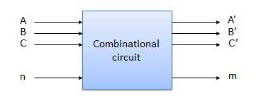
Combinational Circuit
Combinational circuit is a circuit in which we combine the different gates in the circuit, for example, Adder, Subtractor, encoder, decoder, multiplexer and de-multiplexer. Some of the characteristics of combinational circuits are following −
Combinational circuits are defined as the time independent circuits which do not depends upon previous inputs to generate any output.
The combinational circuit do not use any memory. The previous state of input does not have any effect on the present state of the circuit.
A combinational circuit can have an n number of inputs and m number of outputs.

Slide 2
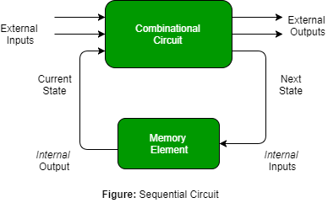
Sequential Circuits
Sequential circuits are those which are dependent on clock cycles i.e. time dependent.
The output of a Sequential Circuit depends on both-past as well as present inputs.
The sequential circuit has memory elements.

Slide 3
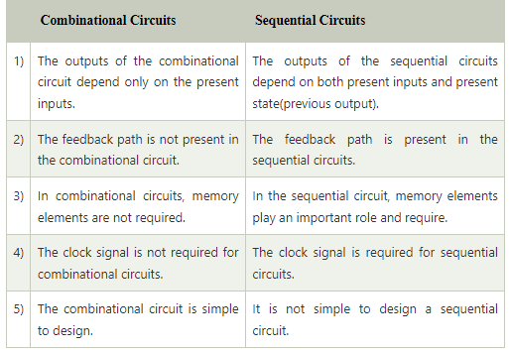
Difference between the Combinational Circuits and Sequential Circuits

Slide 4
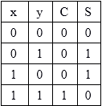
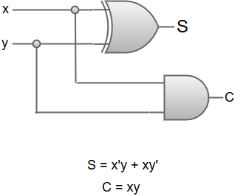
Half Adder
A Half-adder circuit received two binary inputs and produced two binary outputs.
The input variable shows the augend and addend bits whereas the output variable produces the sum and carry.
We can understand the function of a half-adder by formulating a truth table
Truth Table
In the Truth table x and y are the two inputs, and S (Sum) and C (Carry) are the two outputs.
The Carry output is '0' unless both the inputs are 1.
'S' represents the least significant bit of the sum.
The simplified sum of products (SOP) expressions is:
S = x'y+xy', C = xy
The logic diagram for a half-adder circuit can be represented as:

Slide 5
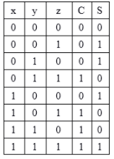
Full Adder
Full adder is developed to overcome the drawback of Half Adder circuit.
The full adder combinational circuit needs three binary inputs and two binary outputs.
Truth Table
Two of the input variable 'x' and 'y', represent the two significant bits to be added.
The third input variable 'z', represents the carry from the previous lower significant position.
The outputs are designated by the symbol 'S' for sum and 'C' for carry.

Slide 6
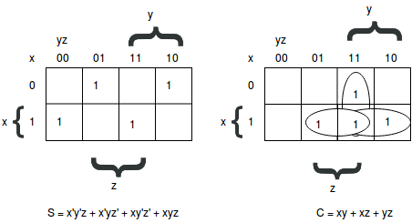
Full Adder
The eight rows under the input variables designate all possible combinations of 0's, and 1's that these variables may have.
The input-output logical relationship of the full-adder circuit may be expressed in two Boolean functions, one for each output variable.
Each output Boolean function can be simplified by using a unique map method.
Maps for a full-adder:

Slide 7
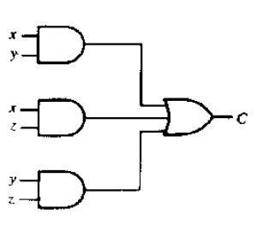
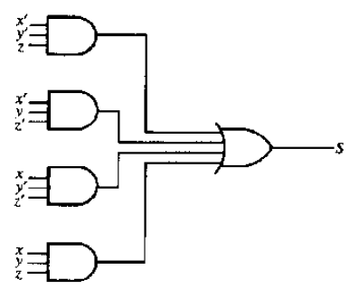
Logic Diagram: SOP

Slide 8
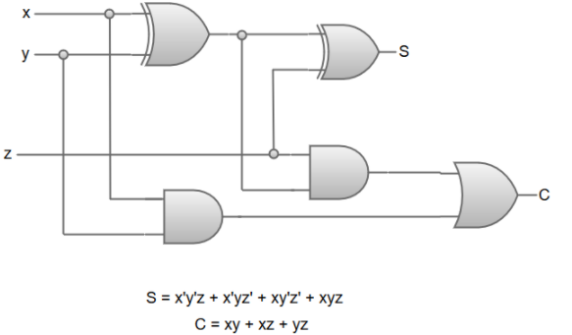
Full Adder using Two half adder

Slide 9
Subtractors
Subtractors are used to subtract the binary numbers. There are two types of subtractors.
Half Subtractor: A half-subtractor is a combinational circuit that subtracts two bits and generates two outputs, one is difference, designated by the symbol D and second is borrow, designated by the symbol B.
Designate the minuend bit by X and the subtrahend bit by y.
To perform x - y, we have to check the relative magnitudes of x and y.
If x >= y, we have three possibilities: 0 - 0 = 0,1 - 0 = 1, and 1 - 1 = O. The result is called the difference bit.
If x < y, we have 0 - 1, and it is necessary to borrow a 1 from the next higher stage.
The 1 borrowed from the next higher stage adds 2 to the minuend bit, just as in the decimal system a borrow adds 10 to a minuend digit. With the minuend equal to 2, the difference becomes 2 - 1 = 1.

Slide 10
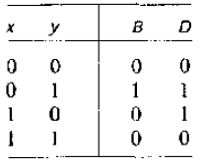
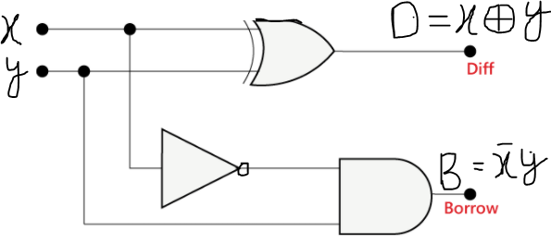
Truth Table for Half-Subtractor
Truth Table
The Boolean functions for the two outputs of the half-subtractor are derived directly from the truth table:
D = x'y + xy'
B = x'y
Logic Gate

Slide 11
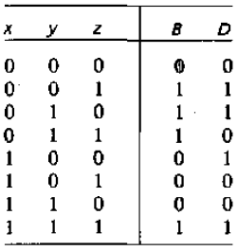
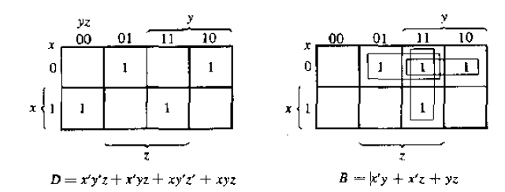
Full Subtractors
A full-subtractor is a combinational circuit that performs a subtraction between two bits, taking into account that a 1 may have been borrowed by a lower significant stage. This circuit has three inputs and two outputs.
The three inputs, x, y, and z, denote the minuend, subtrahend, and previous borrow, respectively. The two outputs, D and B, represent the difference and output borrow, respectively.
Truth Table

Slide 12
Logic Gate:
Boolean Expression
D = x'y'z + x'yz' + xy'z' + xyz
B = x'y + x'z + yz

Slide 13
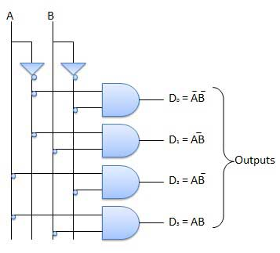
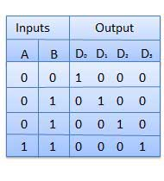
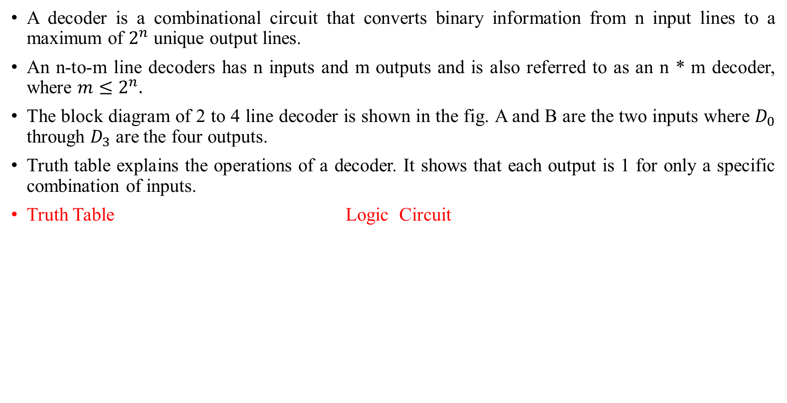
Decoder
A decoder is a combinational circuit that converts binary information from n input lines to a maximum of $2^{n}$ unique output lines.
An n-to-m line decoders has n inputs and m outputs and is also referred to as an n * m decoder, where $m≤2^{n}.$
The block diagram of 2 to 4 line decoder is shown in the fig. A and B are the two inputs where $D_{0}$ through $D_{3}$ are the four outputs.
Truth table explains the operations of a decoder. It shows that each output is 1 for only a specific combination of inputs.
Truth Table Logic Circuit

Slide 14
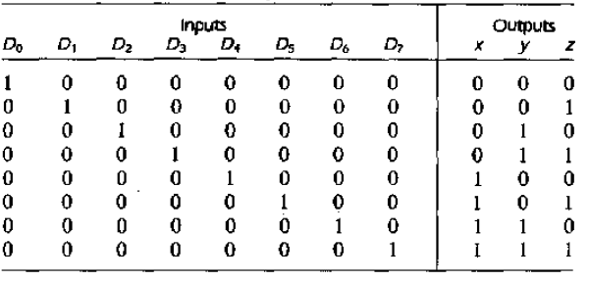
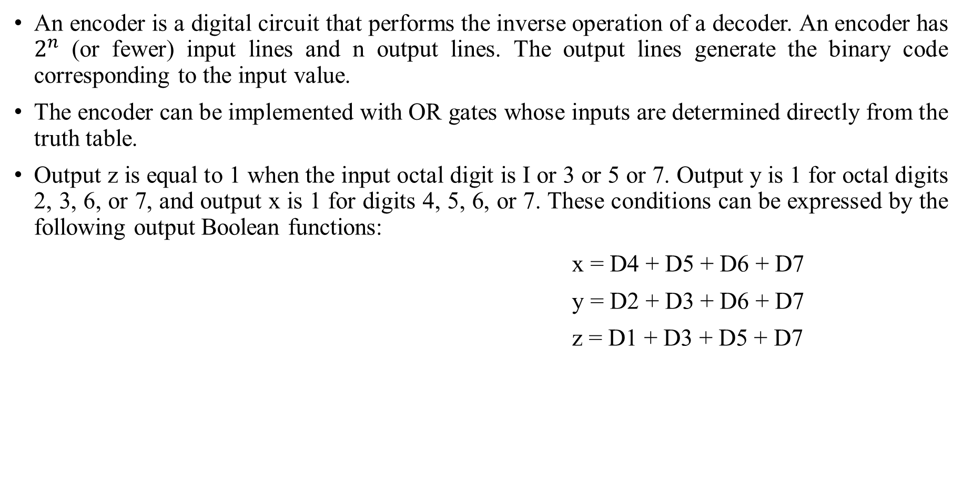
Encoder
An encoder is a digital circuit that performs the inverse operation of a decoder. An encoder has $2^{n}$ (or fewer) input lines and n output lines. The output lines generate the binary code corresponding to the input value.
The encoder can be implemented with OR gates whose inputs are determined directly from the truth table.
Output z is equal to 1 when the input octal digit is I or 3 or 5 or 7. Output y is 1 for octal digits 2, 3, 6, or 7, and output x is 1 for digits 4, 5, 6, or 7. These conditions can be expressed by the following output Boolean functions:
x = D4 + D5 + D6 + D7
y = D2 + D3 + D6 + D7
z = D1 + D3 + D5 + D7

Slide 15
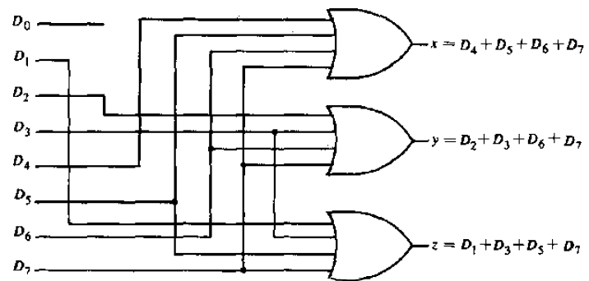
Encoder:-Logic Gate

Slide 16
Multiplexer
Multiplexing means transmitting a large number of information units over a smaller number of channels or lines.
A digital multiplexer is a combinational circuit that selects binary information from one of many input lines and directs it to a single output line.
Multiplexer is a combinational circuit that has maximum of 2^{n} data inputs, ‘n’ selection lines and single output line. One of these data inputs will be connected to the output based on the values of selection lines.
Since there are ‘n’ selection lines, there will be 2^{n} possible combinations of zeros and ones. So, each combination will select only one data input.
Simply, the multiplexer is a multi-input and single-output combinational circuit. A multiplexer is also treated as Mux.
Multiplexers are also known as “Data n selector, parallel to serial convertor, many to one circuit​”.

Slide 17
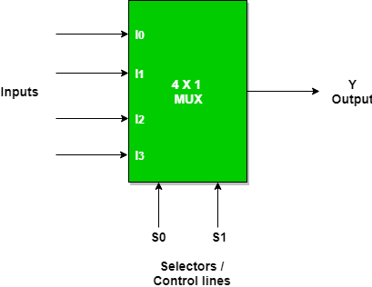
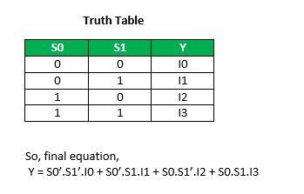
Multiplexer
Block Diagram: 4x1 Multiplexer has four data inputs I₃, I₂, I₁ & I₀, two selection lines s₁ & s₀ and one output Y. The block diagram of 4x1 Multiplexer is shown in the following figure.
Block Diagram Truth Table:

Slide 18
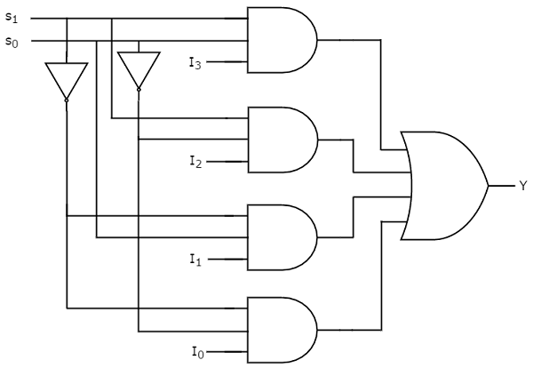
Multiplexer
Logic Diagram

Slide 19
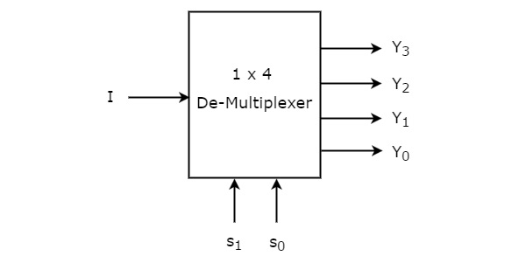
De-Multiplexer
De-Multiplexer is a combinational circuit that performs the reverse operation of Multiplexer. It has single input, ‘n’ selection lines and maximum of 2^{n} outputs. The input will be connected to one of these outputs based on the values of selection lines.
Since there are ‘n’ selection lines, there will be 2^{n} possible combinations of zeros and ones. So, each combination can select only one output. De-Multiplexer is also called as De-Mux.
Block Diagram: 1x4 De-Multiplexer has one input I, two selection lines, s₁ & s₀ and four outputs Y₃, Y₂, Y₁ &Y₀. The block diagram & Truth table of 1x4 De-Multiplexer is shown in the following figure.

Slide 20
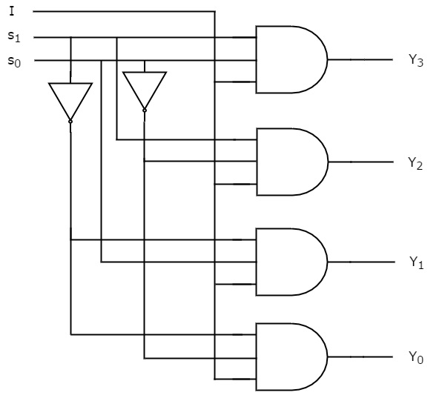
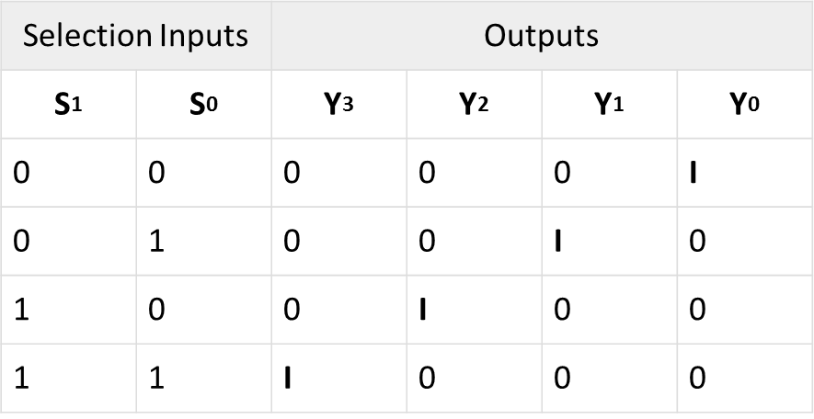
De-Multiplexer
Truth Table: Logic Diagram:
From the above Truth table, we can directly write the Boolean functions for each output as
Y3=s1s0I
Y2=s1s0′I
Y1=s1′s0I
Y0=s1′s0′I

